Slide 1

Face Recognition Using ESP32-CAM

Slide 2
Team members
Name | ID
Amina Elshabandy | 222100306
Sherif Farag | 222100822
Aser Mohamed | 2222102487
Ziad Abdelrahman | 221101043
Mohamed Ahmed | 221101699
Ahmed Mohamed | 221100116

Slide 3
1 Introduction

Slide 4
Introduction
Overview:
project leverages the capabilities of an ESP32-CAM module, OLED, and TTL to create a facial recognition system. Our system identifies and recognizes faces in real-time, utilizing both pre-trained datasets and personalized training data.
Why Facial Recognition: Facial recognition has applications in security, authentication, and automation, making it an essential technology in today's AI-driven world

Slide 5
Aim and Approach
Aim:
To develop a reliable and efficient facial recognition system capable of recognizing faces from custom datasets for enhanced personalization
What We Did:
1-Conducted initial testing using a celebrity face dataset
2-Transitioned to custom training with our own facial images for a more personalized system
3-Implemented the system using ESP32-CAM for image capture and laptop for processing

Slide 6
2 datasets

Slide 7
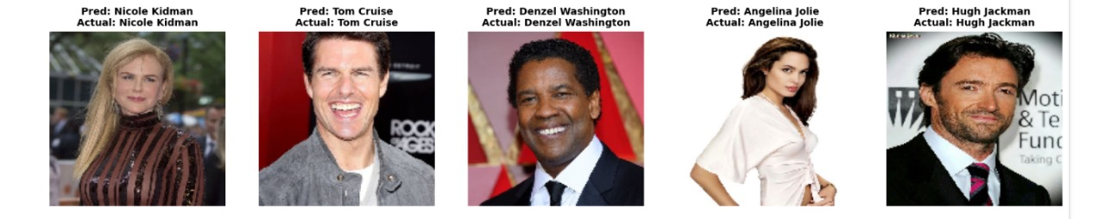
premade dataset

Slide 8

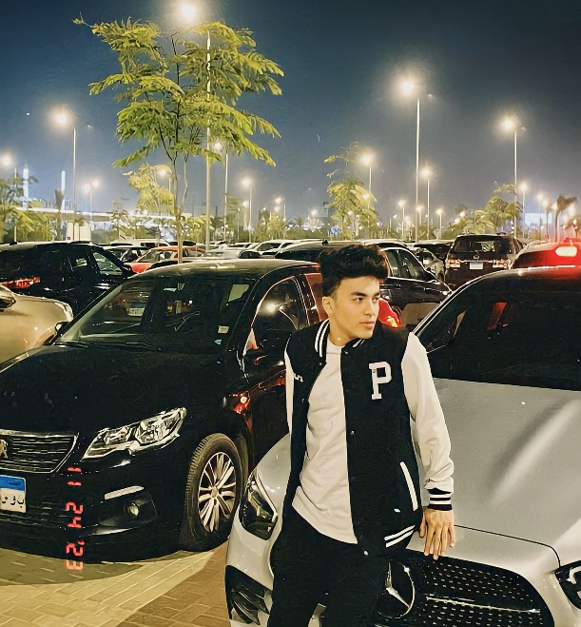




custom dataset

Slide 9
3 preprocessing

Slide 10
Preprocessing
Image Collection:
Collected initial data from a celebrity faces dataset for testing.
Captured custom facial images using the ESP32-CAM module for personalized training.
Preprocessing Steps:
Resized images to a standard resolution suitable for the model.
Converted images to grayscale or normalized pixel values to improve model performance.
Applied data augmentation techniques like rotation, flipping, and cropping to expand the dataset.

Slide 11
Preparing Data for the Model
Data Splitting:
Divided the dataset into training, validation, and testing sets.
Feature Extraction:
Used pre-trained neural networks (if applicable) for feature extraction or trained the system from scratch on the custom data.
Model Input Format:
1-Converted images into tensors suitable for input into the neural network.
2-Batched data for efficient training and evaluation
Integration with Hardware:
Configured the ESP32-CAM to continuously stream real-time images.

Slide 12
3 Model Architecture

Slide 13
Model Architecture
Type: Convolutional Neural Network (CNN)
Framework: TensorFlow/Keras
Purpose:
Automatically detects patterns in image data.
Classifies faces into different categories.
Main Features:
Filters (32, 64, 128) detect increasingly complex patterns.
Uses ReLU activation to speed up learning.
MaxPooling reduces image size to focus on important features.

Slide 14
Layer Breakdown
Input Layer:
Takes 150x150 RGB images.
Convolutional Layers:
Extracts patterns like edges or textures.
Three layers with increasing filters (32, 64, 128).
Pooling Layers:
MaxPooling (2x2) reduces image size but keeps key info
Flatten Layer:
Converts 2D feature maps into a 1D array
Dense Layer:
Fully connected layer with 512 neurons (ReLU)
Dropout:
Reduces overfitting by disabling 50% of neurons
Output Layer:
19 neurons for classification (softmax activation)

Slide 15
Model Training Details
Optimizer:
Adam with a learning rate of 0.001.
Loss Function:
Categorical Crossentropy for multi-class classification.
Training Setup:
50 epochs
618 training
228 testing
Why Dropout: Prevents overfitting by forcing the model to generalize better

Slide 16
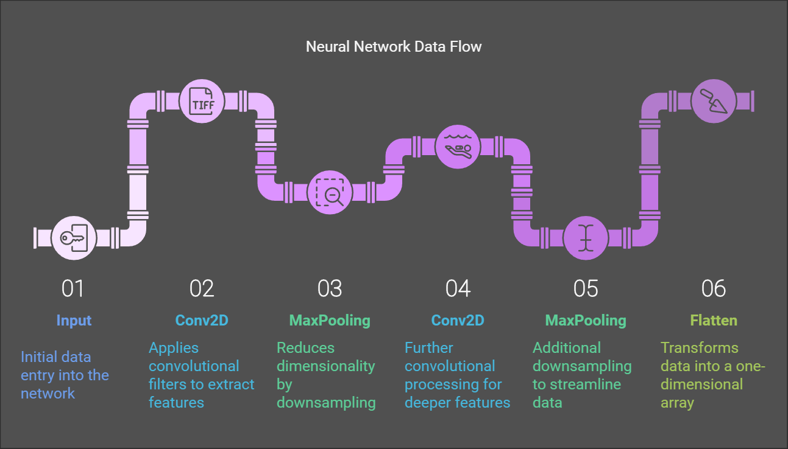
model workflow

Slide 17
4 Hardware

Slide 18
Hardware Components Overview
ESP32-CAM:
A compact, low-cost microcontroller with an integrated camera Used to capture images for facial recognition Supports Wi-Fi for sending data.
OLED Display:
Displays the output, such as the recognized face or other information
TTL Module:
Facilitates communication between hardware components.

Slide 19
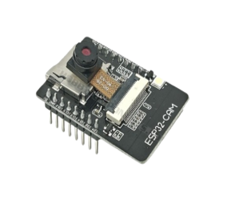
ESP32-CAM
Camera Module:
Captures images with a resolution suitable for facial recognition.
Wi-Fi Capability:
Connect to the device easier, and upload the data on SD Card

Slide 20
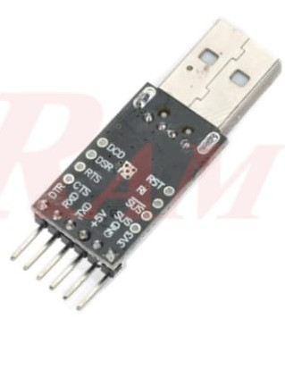
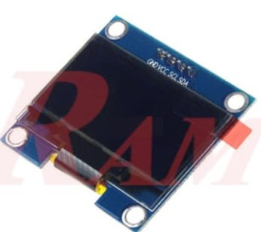
TTl and Oled
Oled Display:
Shows results, e.g., "Face Recognized: [Name].“
TTL Module:
Ensures smooth communication between the camera and Raspberry Pi.

Slide 21
4 Results and Visualization for the premade dataset

Slide 22
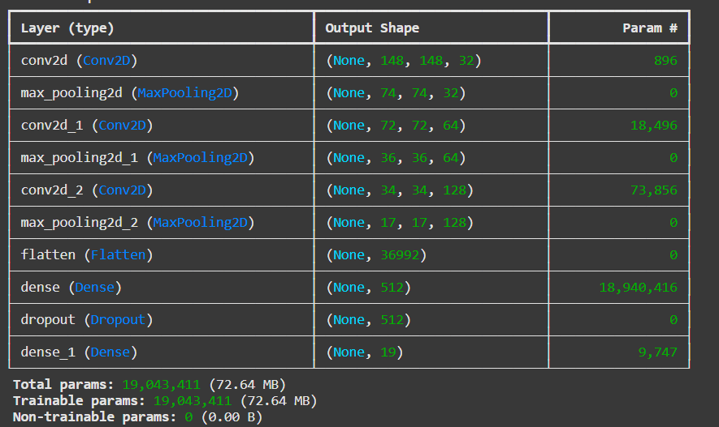
Model layers

Slide 23
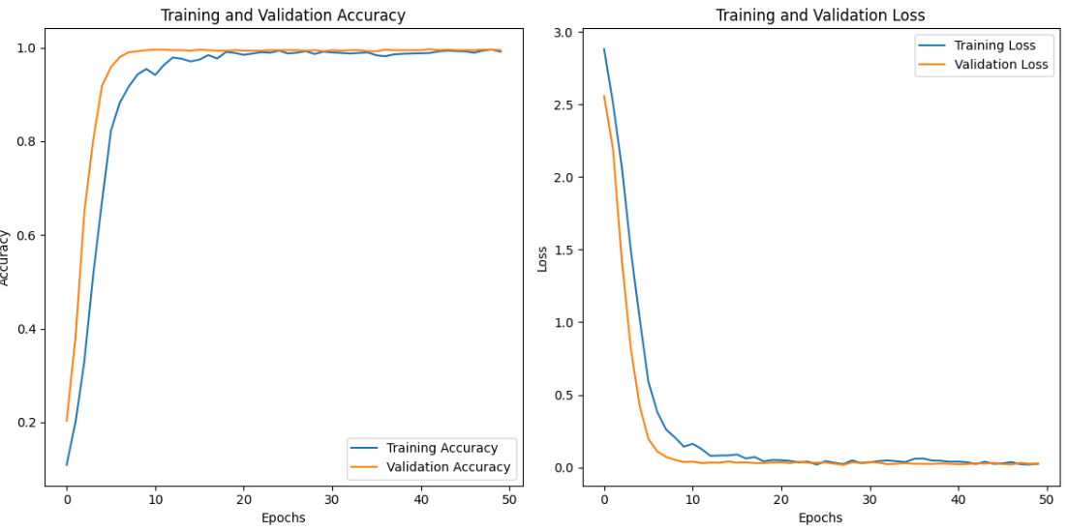
Accuracy and validation

Slide 24
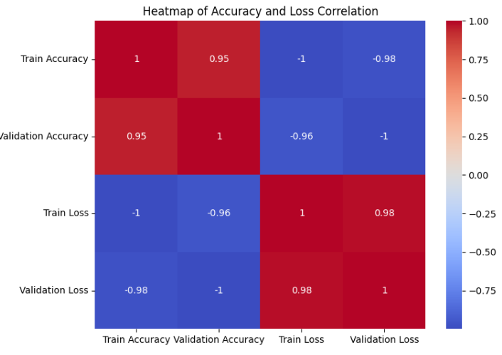
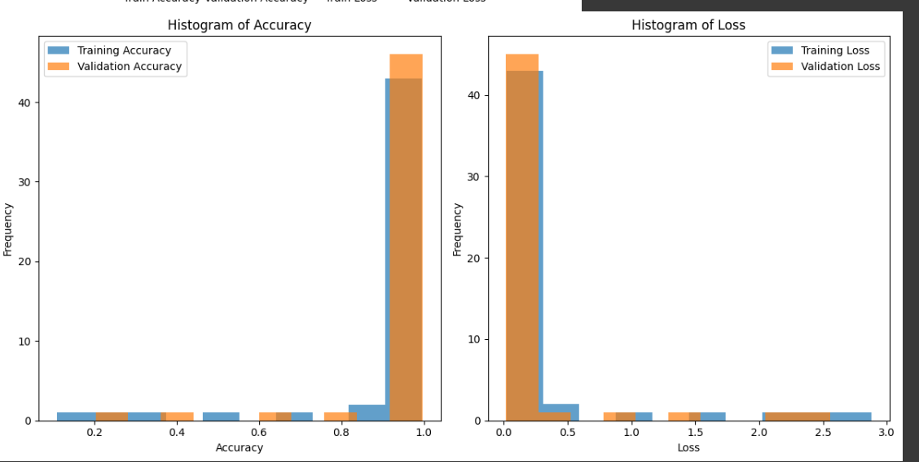
heatmap and histogram

Slide 25
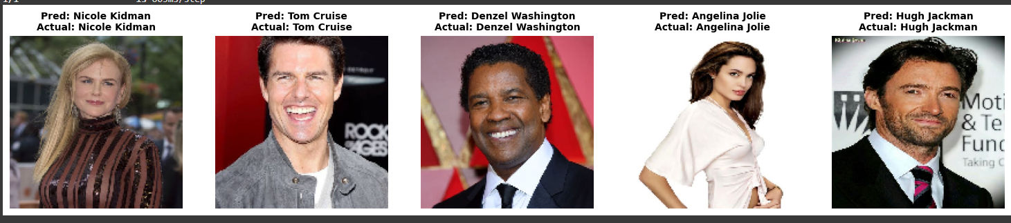
Model prediction

Slide 26
5 Results and Visualization for custom dataset

Slide 27
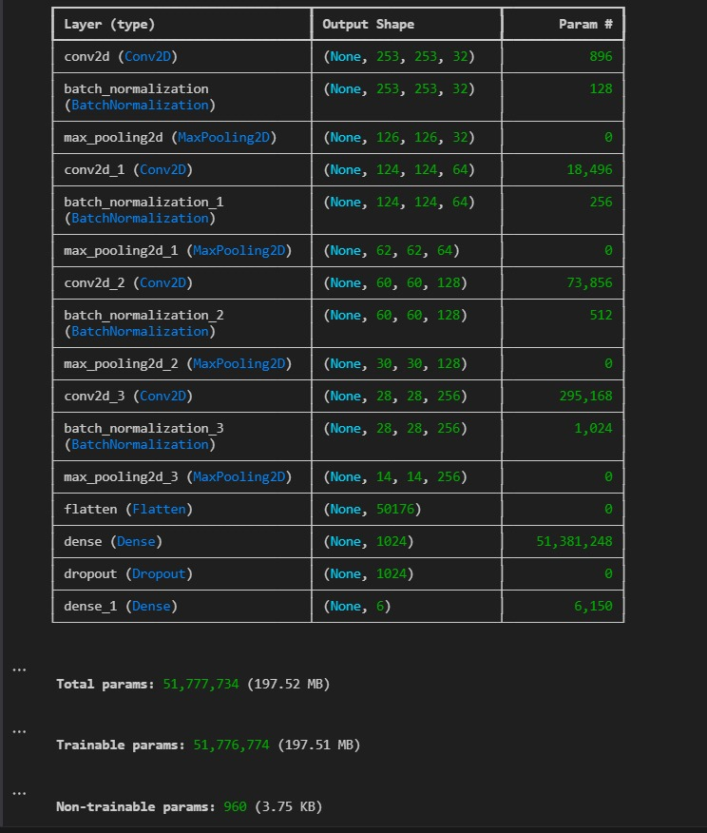
Model layers

Slide 28

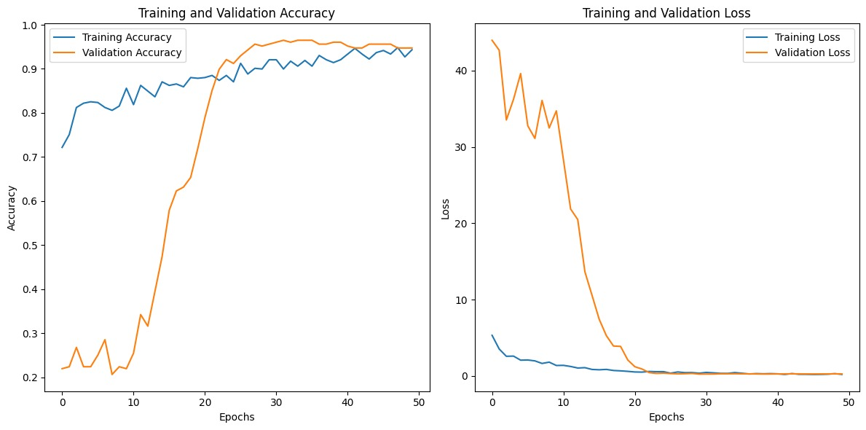
Accuracy and validation

Slide 29
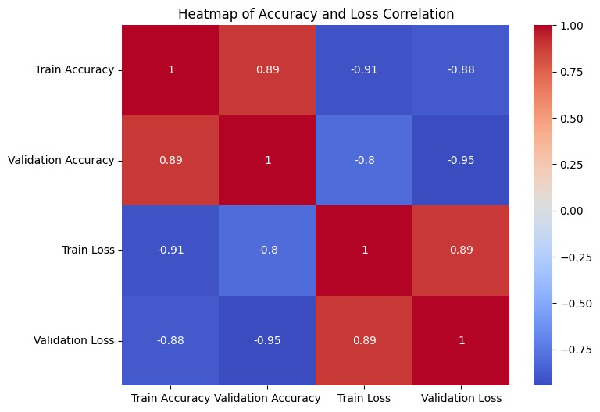
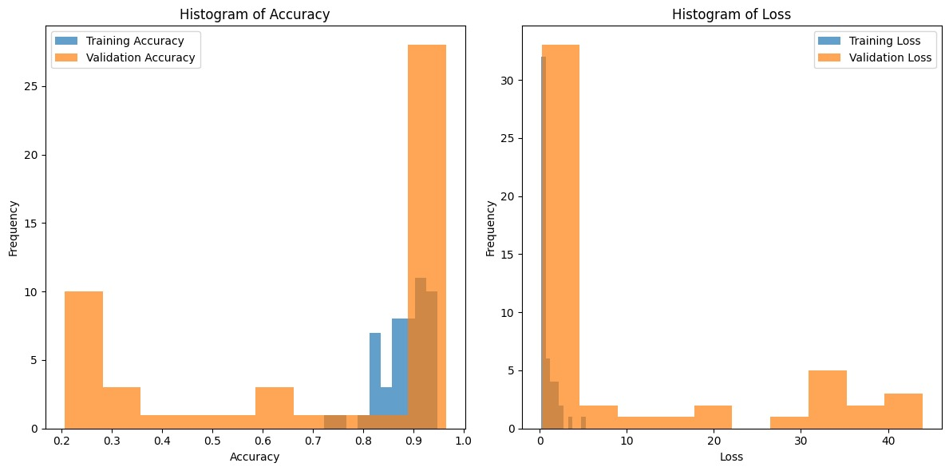
heatmap and histogram

Slide 30
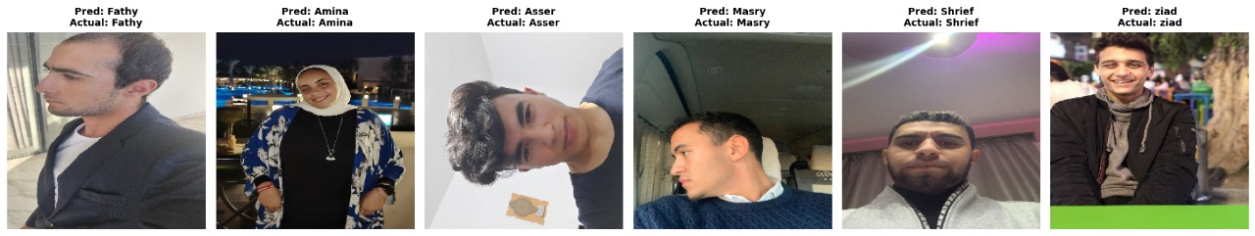
Model prediction

Slide 31
6 Future work

Slide 32
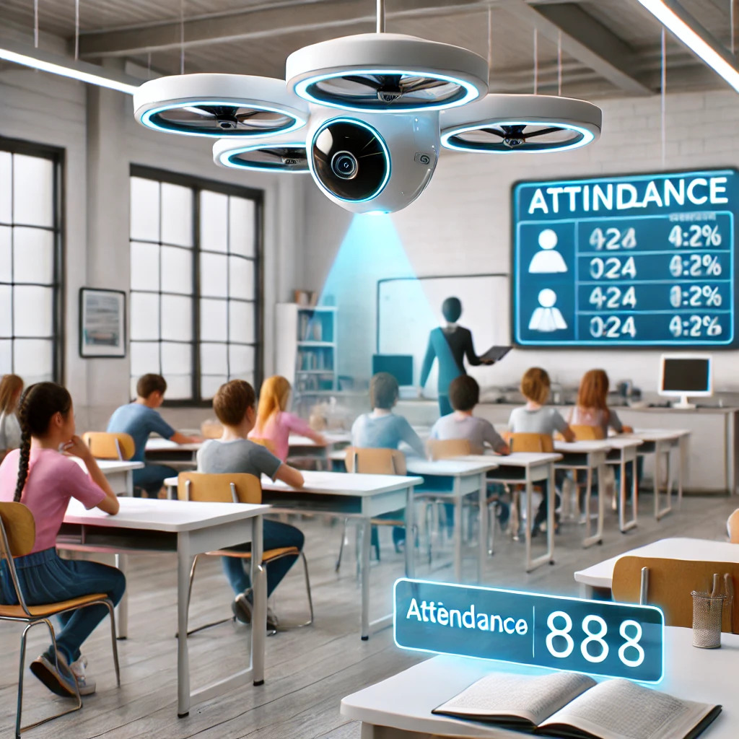
Smart Attendance System
Vision:
Develop a smart attendance system using facial recognition.
Mount the system on a drone to autonomously scan students in a classroom.
Automation:
Eliminates the need for manual attendance-taking.
Efficiency:
Reduces time spent on administrative tasks.
Scalability:
Suitable for large classrooms or outdoor events.

Slide 33
6 Conclusion

Slide 34
Conclusion
The ESP32-CAM, TTL, and OLED-based smart attendance system is a simple yet effective solution for automating attendance. It uses facial recognition to make the process fast and accurate, removing the need for traditional methods like manual registers or RFID cards. The TTL ensures smooth communication between components, and the OLED display provides clear, real-time updates for users.
This system is compact, affordable, and easy to set up, making it suitable for schools, offices, or any place where attendance tracking is needed. While it works well as is, it can be improved further by adding features like cloud storage for attendance records or mobile app integration for remote access.
Overall, it’s a practical and modern way to simplify attendance management.

Slide 35
Any Questions?

Slide 36
Thank You

